Slide 1
Distribution Waterfall Illustration Deal-by-Deal (American) vs. Whole Fund (European)
Charles J. Spiller
Deputy CIO, Non-Traditional Investments
December 7, 2017

Slide 2
Introduction
The Distribution Waterfall (Waterfall) specifies how the proceeds from a fund’s realized investments are distributed to the Limited Partner’s (LP’s) and General Partner (GP).
Two main types
Deal-by-Deal, also known as American and
Whole Fund, also known as European
Waterfall specifics vary, as negotiated in the Limited Partner Agreement (LPA)

Slide 3
Definitions
Drawn Capital* – Amount paid by LP to GP to fund investments
Management Fee – PSERS strives to negotiate a reduced management fee based on the size of commitment, involvement in the first close, and/or being a founding investor in the initial fund. This fee is paid to the General Partner from each investor directly on a pro rata basis. Management fees are part of the capital commitments Limited Partners make and are returned with interest as distributions are made.
Preferred Return – The preferred return, or hurdle rate, is the threshold return that the Limited Partners must receive prior to the General Partner receiving its profit share.
Generally, PSERS receives a preferred return of 8% (compounded annually) which is calculated on Drawn Capital and Management Fees.
Catch-Up – After the Limited Partners have received their preferred return, the General Partner receives a percentage (typically 50%-100%) of the next distributions until the total investment gain distributions equal the profit share ratio, generally allocated 80% to the Limited Partners and 20% to the General Partner.
Profit Share – Profit share is the net investment gain that is split between the Limited Partners and General Partner. Typically, the Limited Partners receive 80% and the General Partner 20%. The General Partner’s profit share is the primary economic incentive for the General Partner.
Clawback – A clawback requires that distributions are periodically reconciled. If the General Partner has received excess distributions (greater than its Profit Share), the General Partner is required to return the excess distributions to the Limited Partners.
The clawback is generally supported by an escrow or a guarantee.
* Generally, Drawn Capital includes investment cost and management fees. For purposes of this presentation Drawn Capital (investment cost in this presentation) and Management Fees are shown individually for illustration purposes.

Slide 4
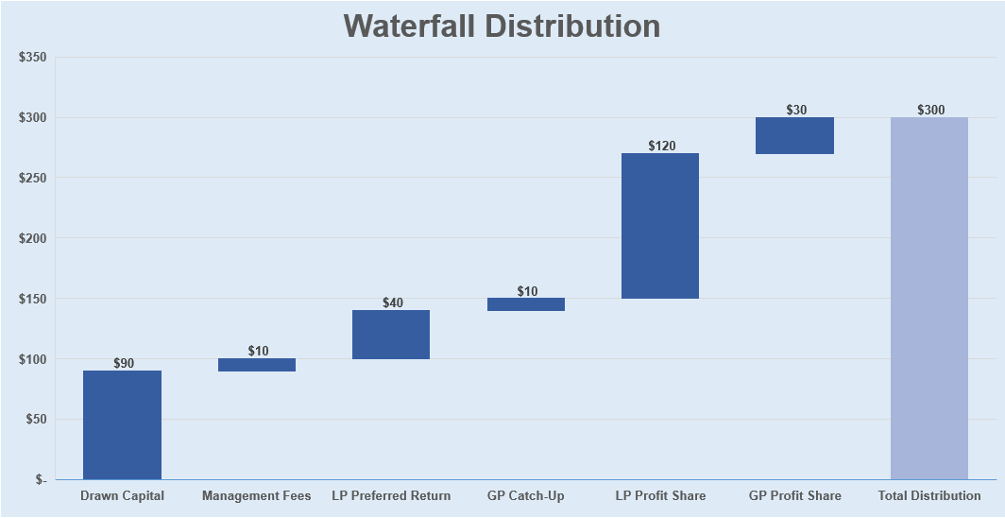
Distribution Illustration ($100 M Commitment; $90 M Invested; 2% Management Fee; 8% Preferred Return; 20% Catch-Up; Five-Year Period)
Thereafter
First Priority
Second Priority
Third Priority
Amounts Distributed to LP only
Amounts are split 80/20
Amounts in millions of dollars

Slide 5
Assumptions for Illustration
PSERS’ Commitment - $100 M
Fund life – 10 years
Investment period – 5 years
Harvesting period – 5 years
Management fee:
2% of commitment during investment period,
2% of invested capital thereafter
Preferred Return – 8%
GP Catchup – 20%
Profit Share:
LP – 80%
GP – 20%

Slide 6
Portfolio Investments
Drawn Capital Summary
 | Invested |  | Realized
 | Year | Amount | Year | Amount
Investment A | Year 1 | $ 16,000,000 | Year 3 | $ 40,000,000
Investment B | Year 2 | $ 16,000,000 | Year 5 | $ 64,000,000
Investment C | Year 3 | $ 16,000,000 | Year 7 | $ 48,000,000
Investment D | Year 4 | $ 16,000,000 | Year 8 | $ 48,000,000
Investment E | Year 5 | $ 16,000,000 | Year 10 | $ 16,000,000
 | Total Invested | $ 80,000,000 | Total Realized | $ 216,000,000
Management Fee Summary
Year | Amount | Year | Amount
Year 1 | $ 2,000,000 | Year 6 | $ 960,000
Year 2 | $ 2,000,000 | Year 7 | $ 960,000
Year 3 | $ 2,000,000 | Year 8 | $ 640,000
Year 4 | $ 2,000,000 | Year 9 | $ 320,000
Year 5 | $ 2,000,000 | Year 10 | $ 320,000
Total Management Fees Paid by LP |  |  | $ 13,200,000

Slide 7
Realizations and Distributions of Proceeds
 | Limited Partner |  | General Partner
 | European | American | European | American
Investment A Realization
Return of Drawn Capital | $ 40,000,000 | $ 16,000,000 | $ - | $ -
Return of Management Fees | $ - | $ 2,000,000 | $ - | $ -
Preferred Return | $ - | $ 4,492,800 | $ - | $ -
GP Catch-Up | $ - | - | $ - | $ 1,123,200
Profit Share | $ - | $ 13,107,200 | $ - | $ 3,276,800
 | $ 40,000,000 | $ 35,600,000 | $ - | $ 4,400,000
Investment B Realization
Return of Drawn Capital | $ 40,000,000 | $ 16,000,000 | $ - | $ -
Return of Management Fees | $ 10,000,000 | $ 3,166,667 | $ - | $ -
Preferred Return | $ 14,000,000 | $ 6,580,221 | $ - | $ -
GP Catch-Up | $ - | $ - | $ - | $ 1,645,055
Profit Share | $ - | $ 29,286,445 | $ - | $ 7,321,611
 | $ 64,000,000 | $ 55,033,333 | $ - | $ 8,966,667
Investment C Realization
Return of Drawn Capital | $ - | $ 16,000,000 | $ - | $ -
Return of Management Fees | $ 1,920,000 | $ 3,806,667 | $ - | $ -
Preferred Return | $ 18,372,679 | $ 9,103,361 | $ - | $ -
GP Catch-Up | $ - | $ - | $ 8,093,170 | $ 2,275,840
Profit Share | $ 15,691,321 | $ 13,451,306 | $ 3,922,830 | $ 3,362,826
 | $ 35,984,000 | $ 42,361,333 | $ 12,016,000 | $ 5,638,667

Slide 8
Realizations and Distributions of Proceeds (Continued)
 | Limited Partner |  | General Partner
 | European | American | European | American
Investment D Realization
Return of Drawn Capital | $ - | $ 16,000,000 | $ - | $ -
Return of Management Fees | $ 640,000 | $ 2,126,667 | $ - | $ -
Preferred Return | $ 4,760,017 | $ 9,469,033 | $ - | $ -
GP Catch-Up | $ - | - | $ 1,190,004 | $ 2,367,258
Profit Share | $ 33,127,983 | $ 14,429,634 | $ 8,281,996 | $ 3,607,408
 | $ 40,000,000 | $ 35,600,000 | $ 9,472,000 | $ 5,974,666
Investment E Realization
Return of Drawn Capital | $ - | $ 16,000,000 | $ - | $ -
Return of Management Fees | $ 640,000 | $ - | $ - | $ -
Preferred Return | $ 6,859,811 | $ - | $ - | $ -
GP Catch-Up | $ - | $ - | $ 1,714,953 | $ -
Profit Share | $ 5,428,189 | $ - | $ 1,357,047 | $ -
 | $ 12,928,000 | $ 16,000,000 | $ 3,072,000 | $ -

Slide 9
Summary of Distributions
 | Limited Partner |  | General Partner |  | Totals
Distribution | European | American | European | American | European | American
Return of Drawn Capital | $ 80,000,000 | $ 80,000,000 | $ - | $ - | $ 80,000,000 | $ 80,000,000
Return of Management Fees | $ 13,200,000 | $ 11,100,000 | $ - | $ - | $ 13,200,000 | $ 11,100,000
Preferred Return | $ 43,992,508 | $ 29,645,415 | $ - | $ - | $ 43,992,508 | $ 29,645,415
GP Catch-Up | $ - | $ - | $ 10,998,127 | $ 7,411,354 | $ 10,998,127 | $ 7,411,354
Profit Share | $ 54,247,492 | $ 70,274,585 | $ 13,561,873 | $ 17,568,646 | $ 67,809,365 | $ 87,843,231
 | $ 191,440,000 | $ 191,020,000 | $ 24,560,000 | $ 24,980,000 | $ 216,000,000 | $ 216,000,000
 | Limited Partner |  | General Partner |  | Totals
After Reclass of Mgmt Fee | European | American | European | American | European | American
Return of Drawn Capital | $ 80,000,000 | $ 80,000,000 | $ - | $ - | $ 80,000,000 | $ 80,000,000
Return of Management Fees | $ 13,200,000 | $ 13,200,000 | $ - | $ - | $ 13,200,000 | $ 13,200,000
Preferred Return | $ 43,992,508 | $ 29,645,415 | $ - | $ - | $ 43,992,508 | $ 29,645,415
GP Catch-Up | $ - | $ - | $ 10,998,127 | $ 7,411,354 | $ 10,998,127 | $ 7,411,354
Profit Share | $ 54,247,492 | $ 68,174,585 | $ 13,561,873 | $ 17,568,646 | $ 67,809,365 | $ 85,743,231
 | $ 191,440,000 | $ 191,020,000 | $ 24,560,000 | $ 24,980,000 | $ 216,000,000 | $ 216,000,000

Slide 10
Clawback
 | Limited Partner |  | General Partner |  | Totals
Profit Summary | European | American | European | American | European | American
Preferred Return | $ 43,992,508 | $ 29,645,415 | $ - | $ - | $ 43,992,508 | $ 29,645,415
GP Catch-Up | $ - | $ - | $ 10,998,127 | $ 7,411,354 | $ 10,998,127 | $ 7,411,354
Profit Share | $ 54,247,492 | $ 68,174,585 | $ 13,561,873 | $ 17,568,646 | $ 67,809,365 | $ 85,743,231
 | $ 98,240,000 | $ 97,820,000 | $ 24,560,000 | $ 24,980,000 | $ 122,800,000 | $ 122,800,000
Percentage of Total Profits | 80.00% | 79.66% | 20.00% | 20.34%
In the American Waterfall
The total fund profits were calculated at $122,800,000
This should be distributed 80% or $98,240,000 to the LP and 20% or $24,560,000 to the GP (as shown in the European columns)
LP only received $97,820,000
Therefore, the difference of $420,000 is required to be paid by the GP to the LP as a clawback

Slide 11
Summary
$216,000,000 in gross proceeds were distributed in both waterfalls. The summary of distributions is as follows:
Total Gross Distribution |  | Less Return of Capital |  | Total Net Distributions
European |  | European |  | European
Limtied Partner | General Partner | Limtied Partner | General Partner | Limtied Partner | General Partner
$ 191,440,000 | $ 24,560,000 | $ (93,200,000) | $ - | $ 98,240,000 | $ 24,560,000
Total Gross Distribution |  | Less Return of Capital |  | Total Net Distributions
American |  | American |  | American
Limtied Partner | General Partner | Limtied Partner | General Partner | Limtied Partner | General Partner
$ 191,440,000 | $ 24,560,000 | $ (93,200,000) | $ - | $ 98,240,000 | $ 24,560,000
LP Returns
 | European | American
MoC | 2.05x | 2.05x
IRR | 23.33% | 21.41%

Slide 12
Distribution Waterfall Illustration Deal-by-Deal (American) vs. Whole Fund (European)
Charles J. Spiller
Deputy CIO, Non-Traditional Investments
December 7, 2017

